Slide 1

Final Project Data Analysis
Is there an association of jobs and demographic data

Slide 2
Cleaning the Data (ETL)
Using Jupyter notebook to clean data from the two sources, Buereau of labor statistics and cubit
Metro_city_data_2020 was used to pull an XLS file into the notebook, clean the data, drop null values and then using SQLAlchemy and psycopg2 to push the data to the postgres database hosted in AWS cloud services

Slide 3
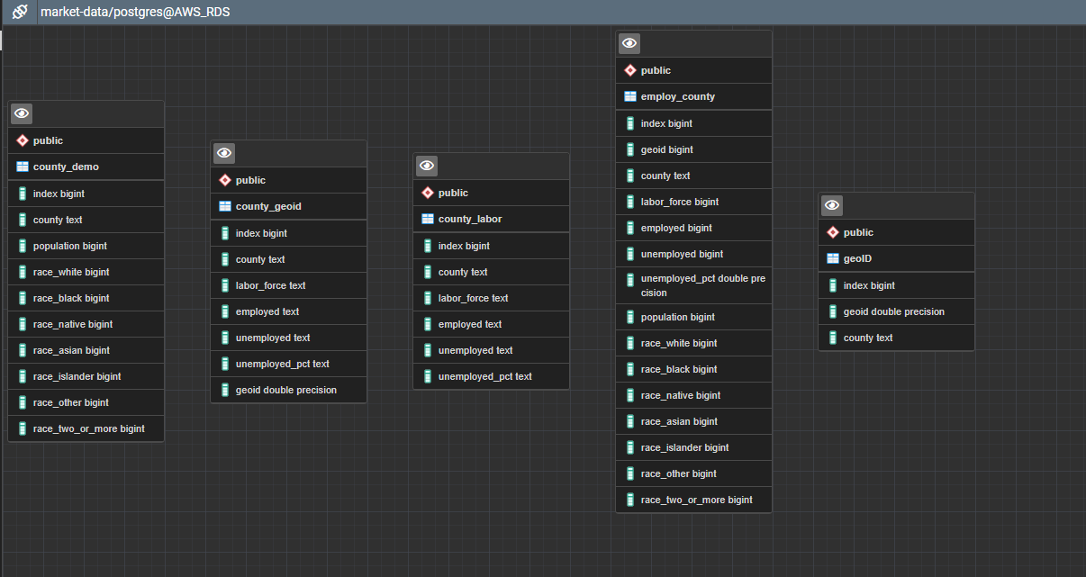
Database
The data is stored in AWS RDS using postgres DB and contains 5 tables

Slide 4
Machine Learning Model

